Slide 1
MGB235 Monitoring and Managing Operational Performance
Week 9 Forecasting
Chapter 3:
Stevenson, W.J. (2021) 14th ed. Operations Management, McGraw Hill, New York, NY.
Chapter 12:
Russell, Roberta S., and Taylor III, Bernard W. (2017) Operations and supply chain
management, 9th ed., Hoboken, NJ.

Slide 2
Lecture Outline
Forecasting and issues related to forecasting
Strategic Role of Forecasting in Supply Chain Management
Components of Forecasting Demand
Time Series Methods
Forecast Accuracy
Introduction

Slide 3
Forecast
Forecast – a statement about the future value of a variable of interest
We make forecasts about such things as weather, demand, and resource availability
Forecasts are important to making informed decisions

Slide 4
Two Important Aspects of Forecasts
Expected level of demand
The level of demand may be a function of some structural variation such as trend or seasonal variation
Accuracy
Related to the potential size of forecast error

Slide 5
Forecasts in Business Organizations
Accounting. New product/process cost estimates, profit projections, cash management.
Finance. Equipment/equipment replacement needs, timing and amount of funding/borrowing needs.
Human resources. Hiring activities, including recruitment, interviewing, and training; layoff planning, including outplacement counseling.
Marketing. Pricing and promotion, e-business strategies, global competition strategies.
MIS. New/revised information systems, internet services.
Operations. Schedules, capacity planning, work assignments and workloads, inventory planning, make-or-buy decisions, outsourcing, project management.
Product/service design. Revision of current features, design of new products or services.

Slide 6
Issues related to forecasting:
What is the point/reason for forecasting?
When can you not use forecasting?
What are some of the key variables in the forecasting process?
What does forecasting mean to management?
What assumptions are being used in the forecasting process?
Macro or micro issues?
12-6

Slide 7
Forecasting Approaches
Qualitative forecasting
Qualitative techniques permit the inclusion of soft information such as:
Human factors
Personal opinions
Hunches
These factors are difficult, or impossible, to quantify
Quantitative forecasting
These techniques rely on hard data
Quantitative techniques involve either the projection of historical data or the development of associative methods that attempt to use causal variables to make a forecast
12-7

Slide 8
Supply Chain Management
Accurate forecasting determines inventory levels in the supply chain
Continuous replenishment
supplier & customer share continuously updated data
typically managed by the supplier
reduces inventory for the company
speeds customer delivery
Variations of continuous replenishment
quick response
JIT (just-in-time)
VMI (vendor-managed inventory)
stockless inventory
Variation – using Twitter
12-8

Slide 9
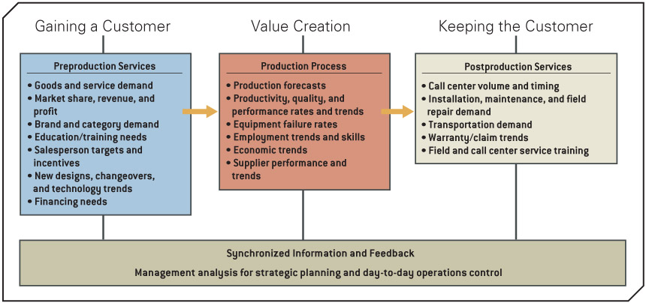
The Need for Forecasts in a Value Chain
9

Slide 10
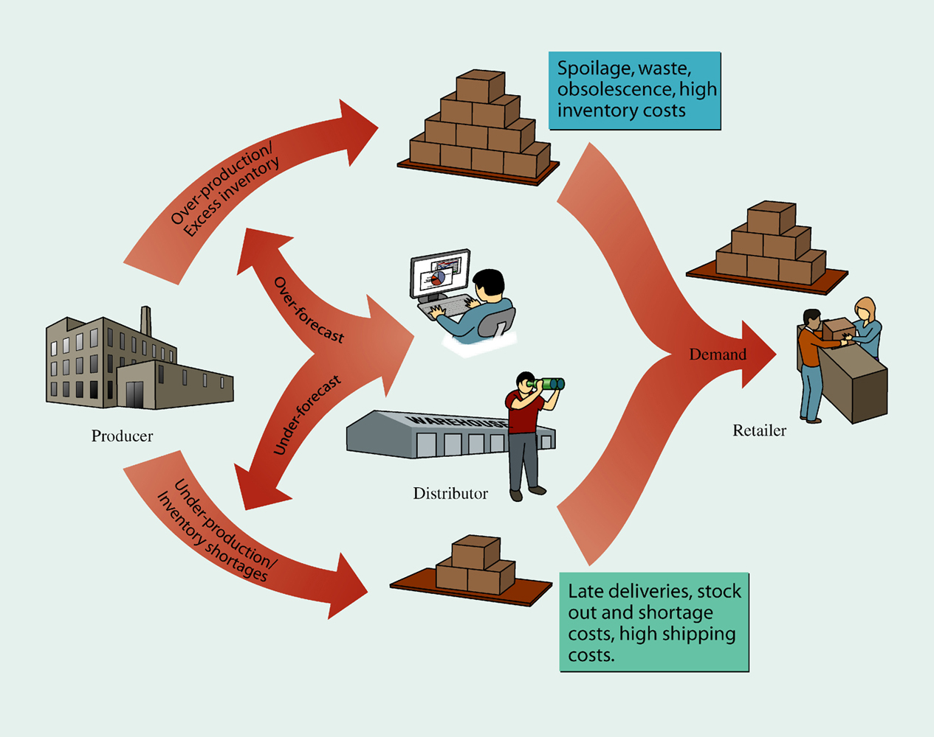
The Effect of Inaccurate Forecasting
12-10

Slide 11
Forecasting
Quality Management
Accurately forecasting customer demand is a key to providing good quality service
Which then has an impact on the supply forecasts which flow through to supply chain management issues
Strategic Planning
Successful strategic planning requires accurate forecasts of future products and markets
12-11

Slide 12
Steps in the forecasting process:
1. Determine the purpose of the forecast
(how will it be used and when will it be needed?)
2. Establish a time horizon
(Must indicate a time horizon)
3. Obtain, clean, and analyse appropriate data
(Getting good data; cleaning up data, outliers)
4. Select a forecasting technique
5. Make the forecast
Monitor the forecast
Ask ‘what if’ questions

Slide 13
Types of Forecasting Methods
Depend on
time frame
demand behavior
causes of behavior
12-13

Slide 14
Time Frame
Indicates how far into the future is forecast
Short- to mid-range forecast
typically encompasses the immediate future
daily up to two years
Long-range forecast
usually encompasses a period of time longer than two years
12-14

Slide 15
Demand Behavior
Trend
a gradual, long-term up or down movement of demand
Random variations
movements in demand that do not follow a pattern
Cycle
an up-and-down repetitive movement in demand
Seasonal pattern
an up-and-down repetitive movement in demand occurring periodically
12-15

Slide 16
Forms of Forecast Movement
Demand
Demand
Random movement
Time
(a) Trend
Time
(b) Cycle
Demand
Demand
Time
(c) Seasonal pattern
Time
(d) Trend with seasonal pattern
12-16

Slide 17
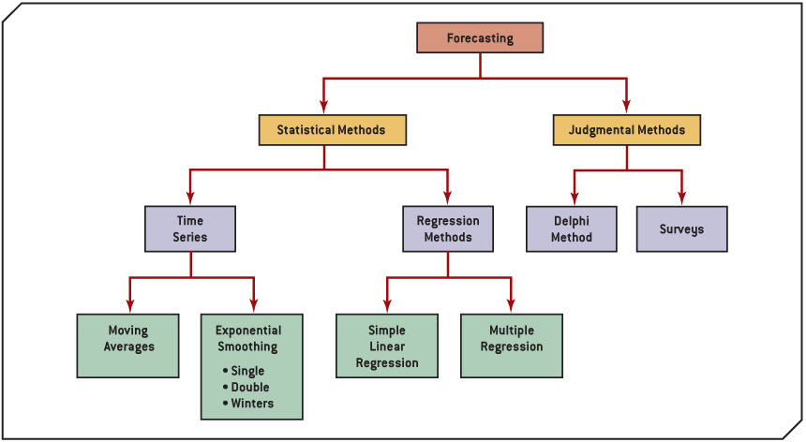
Classification of Basic Forecasting Methods
17

Slide 18
Forecasting Methods
Time series
statistical techniques that use historical demand data to predict future demand
Regression methods
attempt to develop a mathematical relationship between demand and factors that cause its behavior
Qualitative (Judgmental)
use management judgment, expertise, and opinion to predict future demand
12-18

Slide 19
Qualitative Methods
Management, marketing, purchasing, and engineering are sources for internal qualitative forecasts
Delphi method
involves soliciting forecasts about technological advances from experts
12-19

Slide 20
Qualitative (Judgmental) Methods
20
Notes:
Explain each of these types
‘Ask the class if anyone uses these methods”

Slide 21
Forecasting Process
1. Identify the purpose of forecast
2. Collect historical data
3. Plot data and identify patterns
6. Check forecast accuracy with one or more measures
5. Develop/compute forecast for period of historical data
4. Select a forecast model that seems appropriate for data
7.
Is accuracy of forecast acceptable?
No
8b. Select new forecast model or adjust parameters of existing model
Yes
8a. Forecast over planning horizon
9. Adjust forecast based on additional qualitative information and insight
10. Monitor results and measure forecast accuracy
12-21

Slide 22
Statistical Methods: Time Series
Assume that what has occurred in the past will continue to occur in the future
Relate the forecast to only one factor - time
Include
moving average
exponential smoothing
linear trend line
12-22

Slide 23
Moving Average
Naive forecast
demand in current period is used as next period’s forecast
Simple moving average
uses average demand for a fixed sequence of periods
stable demand with no pronounced behavioral patterns
Weighted moving average
weights are assigned to most recent data
12-23

Slide 24
Moving Average: Naive Approach
ORDERS
MONTH PER MONTH
FORECAST
Jan 120
Feb 90
Mar 100
Apr 75
May 110
June 50
July 75
Aug 130
Sept 110
Oct 90
-
120
90
100
75
110
50
75
130
110
90
Nov -
12-24

Slide 25
Simple Moving Average
n
i = 1
Σ
D_{i}
MA_{n} =
n
where
n = number of periods in the moving average
D_{i} = demand in period i
12-25

Slide 26
3-month Simple Moving Average
ORDERS
MONTH PER MONTH
MOVING
AVERAGE
3
i = 1
Σ
D_{i}
Jan 120
Feb 90
Mar 100
Apr 75
May 110
June 50
July 75
Aug 130
Sept 110
Oct 90
Nov -
–
–
–
103.3
88.3
95.0
78.3
78.3
85.0
105.0
110.0
MA₃ =
3
90 + 110 + 130
3
=
= 110 orders for Nov
12-26

Slide 27
5-month Simple Moving Average
ORDERS
MONTH PER MONTH
MOVING
AVERAGE
5
i = 1
Σ
D_{i}
Jan 120
Feb 90
Mar 100
Apr 75
May 110
June 50
July 75
Aug 130
Sept 110
Oct 90
Nov -
–
–
–
–
–
99.0
85.0
82.0
88.0
95.0
91.0
MA₅ =
5
90 + 110 + 130+75+50
5
=
= 91 orders for Nov
12-27

Slide 28
Smoothing Effects
150 –
125 –
100 –
75 –
50 –
25 –
0 –
5-month
Orders
3-month
Actual
| | | | | | | | | | |
Jan Feb Mar Apr May June July Aug Sept Oct Nov
Month
12-28

Slide 29
Weighted Moving Average
Adjusts moving average method to more closely reflect data fluctuations
n
WMA_{n} =
Σ
W_{i} D_{i}
i = 1
where
W_{i} = the weight for period i, between 0 and 100 percent
Σ W_{i} = 1.00
12-29

Slide 30
Weighted Moving Average Example
MONTH WEIGHT DATA
August 17% 130
September 33% 110
October 50% 90
3
i = 1
November Forecast
WMA₃ =
Σ
W_{i} D_{i}
= (0.50)(90) + (0.33)(110) + (0.17)(130)
= 103.4 orders
12-30

Slide 31
Exponential Smoothing
Averaging method
Weights most recent data more strongly
Reacts more to recent changes
Widely used, accurate method
12-31

Slide 32
Exponential Smoothing
F_{t +1} = α D_{t} + (1 - α)F_{t}
where:
F_{t +1} = forecast for next period
D_{t} = actual demand for present period
F_{t} = previously determined forecast for present period
α = weighting factor, smoothing constant
12-32

Slide 33
Effect of Smoothing Constant
0.0 ≤ α ≤ 1.0 If α = 0.20, then F_{t +1} = 0.20 D_{t} + 0.80 F_{t}
If α = 0, then F_{t +1} = 0 D_{t} + 1 F_{t} = F_{t} Forecast does not reflect recent data
If α = 1, then F_{t +1} = 1 D_{t} + 0 F_{t} = D_{t} Forecast based only on most recent data
12-33

Slide 34
Seasonal Adjustments
Repetitive increase/ decrease in demand
Use seasonal factor to adjust forecast
D_{i}
∑D
Seasonal factor = S_{i} =
12-34

Slide 35
Forecast Accuracy
Forecast error
difference between forecast and actual demand
MAD
mean absolute deviation
MAPD
mean absolute percent deviation
Cumulative error
Average error or bias
12-35

Slide 36
Forecast error (e_{t}) is the difference between the observed value of the time series and the forecast, or A_{t} – F_{t}.
Mean Square Error (MSE)
Mean Absolute Deviation Error (MAD)
Mean Absolute Percentage Error (MAPE)
Chapter 11 Forecasting and Demand Planning
36

Slide 37
Mean Absolute Deviation (MAD)
| D_{t} - F_{t} |
n
MAD =
where
t = period number
D_{t} = demand in period t
F_{t} = forecast for period t
n = total number of periods
⎥ ⎥ = absolute value

Slide 38
MAD Example
PERIOD DEMAND, D_{t} F_{t} (α =0.3) (D_{t} - F_{t}) |D_{t} - F_{t}|
1 37 37.00 – –
2 40 37.00 3.00 3.00
3 41 37.90 3.10 3.10
4 37 38.83 -1.83 1.83
5 45 38.28 6.72 6.72
6 50 40.29 9.69 9.69
7 43 43.20 -0.20 0.20
8 47 43.14 3.86 3.86
9 56 44.30 11.70 11.70
10 52 47.81 4.19 4.19
11 55 49.06 5.94 5.94
12 54 50.84 3.15 3.15
557 49.31 53.39
12-38

Slide 39
MAD Calculation
| D_{t} - F_{t} |
n
MAD =
=
= 4.85
53.39
11

Slide 40
Other Accuracy Measures
Mean absolute percent deviation (MAPD)
∑|D_{t} - F_{t}|
∑D_{t}
MAPD =
Cumulative error
E = ∑e_{t}
Average error
∑e_{t}
n
E =
12-40

Slide 41
Comparison of Forecasts
FORECAST MAD MAPD E (E)
Exponential smoothing (α = 0.30) 4.85 9.6% 49.31 4.48
Exponential smoothing (α = 0.50) 4.04 8.5% 33.21 3.02
Adjusted exponential smoothing 3.81 7.5% 21.14 1.92
(α = 0.50, β = 0.30)
Linear trend line 2.29 4.9% – –
12-41

Slide 42
Choosing a forecasting technique
Cost
Accuracy
Availability of data
Availability of resources, expertise
Forecast horizon
Use multiple techniques where relevant.
And if you get it wrong…
42

Slide 43
Operations Strategy & Forecasting
The better forecasts are, the more able organizations will be to take advantage of future opportunities and reduce potential risks
A worthwhile strategy is to work to improve short-term forecasts
Accurate up-to-date information can have a significant effect on forecast accuracy:
Prices
Demand
Other important variables
Reduce the time horizon forecasts have to cover
Sharing forecasts or demand data through the supply chain can improve forecast quality

Slide 44
Summary:
Forecasting is an integral part of managing operations
Forecasting is an attempt to predict the future, using the best available data
There are a range of forecasting methods
No method is infallible
All forecasting relies on the quality and quantity of the available information
The data generated by forecasting is used to make decisions – the data of itself will not decide for you
12-44

Slide 45
Week 10 Lecture: Inventory Management (Please watch pre-recorded lecture on Canvas/Echo360 - No online or on campus lecture in Week 10)

